Slide 1
Brief Introduction to C Internals
Organised & Supported by RuggedBOARD
Notes:
<number>

Slide 2
Agenda
Home Automation
Goal of this Internship
Why C program?
Structure of C program
I/O instructions
Compiling and Running “Hello world “ example
Basic Data Types
Derived Data Types
Data Types & Range
Variable
Notes:
<number>

Slide 3
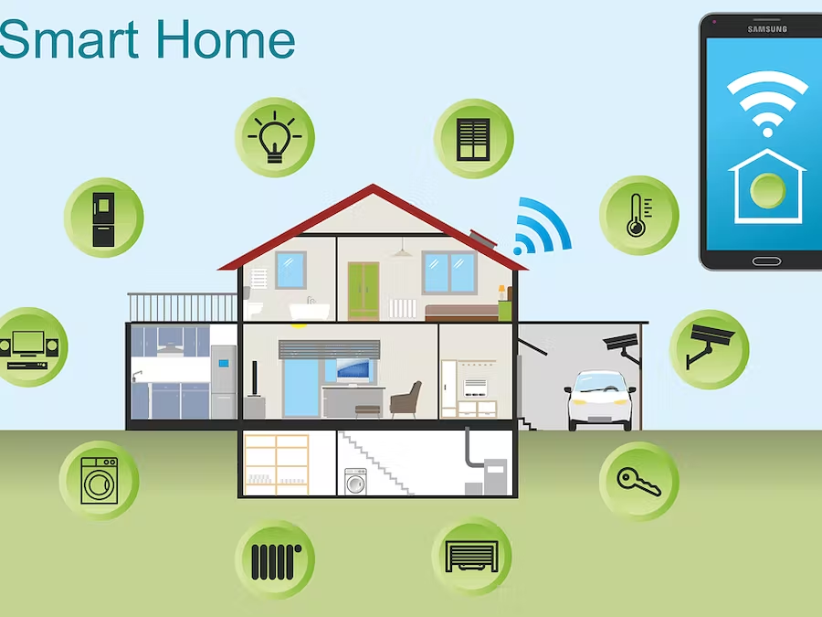
Home Automation
What are the components need to make Smart Home?

Slide 4
Home Automation
1.Wifi internet connection
2.Need to control my AC
3.Sensors
4.Cameras
5.Security system
6.Microcontroller
7.Customised Embedded board
8.Automatic gate lock and open
9.Through Mobile need to access
10.Microwave oven
11.Health gadgets
With one device where I can control all the system in Home.
Example:SBC ( Single Board Computer)

Slide 5
Goal of this Internship
To achieve this we need to gain knowledge about those controling devices and to interface those devices.
Example:Communictions protocols like UART,SPI,I2C ,Mqtt,Webserver etc
Most importantly programming languages like C , Python
End of this Eight week intership all must complete atleast one project
Note: In this course all above requirements are covered in eight weeks

Slide 6
Why C program?
Being a middle-level language, C reduces the gap between the low-level and high-level languages.
It is used for writing operating systems (OS) as well as doing application level programming.
We can do inline assembly code inside C program to access registers of the processor.
C is extensively used in Embedded Programming.
[Embedded Programming is also referred to as micro-controller programming,where C program is used to control micro-controllers. Microcontrollers and embedded programming is widely used in auto-motives, Robotics, Hardware etc]

Slide 7
Structure of C-Program
A C program basically consists of the following parts −
Preprocessor Commands
Functions
Variables
Statements & Expressions
Comments
#include <stdio.h> //Preprocessor Commands
int main() // Program execution begins
{
/* my first program in C */ //comments
printf("Hello, World! \n"); // Display the output in screen
return 0; //Program termintaes hetre
}
Header file:​
- It is a pre-defined program.​
- It contains function (Sub programs), variables and constants etc.​
​
Syn: # include <headerfile>​
​
Here, the symbol '#' reps. pre-processor.
The word "include" is a​ system code.
main ()​
Here, the word main is followed by a pair of parentheses (). ​
That represents a function.​
​
Each and Every C program must start its execution from this point only.​
​
This is defined by programmer only. so, it is user – defined function.
Notes:
<number>

Slide 8
I/O Instructions
To read data from key board (std. input device) using a statement.
That is called "Input instruction".
To display the information on the monitor (std. output device) using a
statement. That is called "OutputInstruction".
Syn: scanf ( ) ; //This is the standard input instruction in C.
printf ( ) ; //This is the standard output Instruction in C.
Notes:
<number>

Slide 9
I/O Instructions – scanf printf
It is a Library function.
It is defined in the header file 'stdio.h'.
It can read any type of data from KB (Std. input device).
It is the standard input function in C language.
Syn : scanf (" formatting chars " , list of vars);
Ex: scanf(" %d " , &num );
It is a Library function.
it is defined in the header file 'stdio.h'.
It can display any type of messages on the monitor only.
Syn: printf("Formatting string " , List of variables);
Ex: printf(" Roll No = %d Name = %s Average = %f " , no, name, per );
Notes:
<number>

Slide 10
Compiling and Running “Hello world “ example
#include <stdio.h> //Header
Int main()
{
printf("Hello World!\n");
}
Compiling and Running on Linux:
$ gcc test.c
The resulting executable file is a.out file.
To run this executable you must type:
$ ./a.out
Notes:
<number>

Slide 11
C program
Program execution
Notes:
<number>

Slide 12
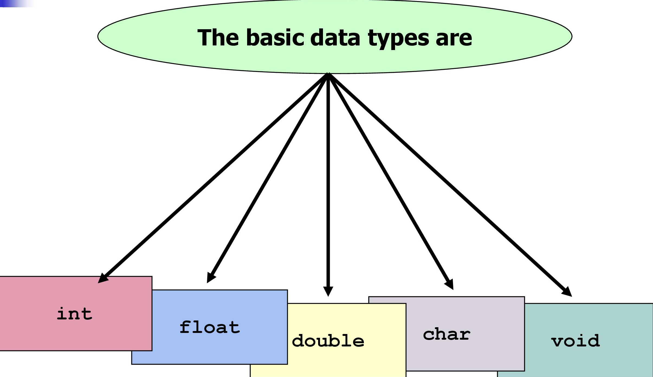
Basic data type
Notes:
<number>

Slide 13
Basic Data Types
Data types :
A data type describes the kind of data that will fit into the name of the variable is preceded with the data type .
Syntax : data type variblename
Ex: int varName
The basic data types
Int , float , char , double , void
Notes:
<number>

Slide 14
Type int ,float, char
Stores numeric data​
int num;​
[Cannot store any other type of data like "Alan" or "abc" ]​
32 bits (4 bytes) ​
Integers in the range -65545 to 65545 ​
Examples: 12322, O, -232
Stores values containing decimal places​
float num;​
Precision of upto 6 digits ​
32 bits (4 bytes) of memory ​
Examples: 23.05, 56.5, 32
Stores a single character of information ​
char gender ; ​
gender= 'M'​
8 bits (1 byte) of memory ​
Examples: 'a', 'm’,’$’,’%’,’1’,’5’...​
Type void ​
Stores nothing​
[Indicates the compiler that there is nothing to expect]
Notes:
<number>

Slide 15
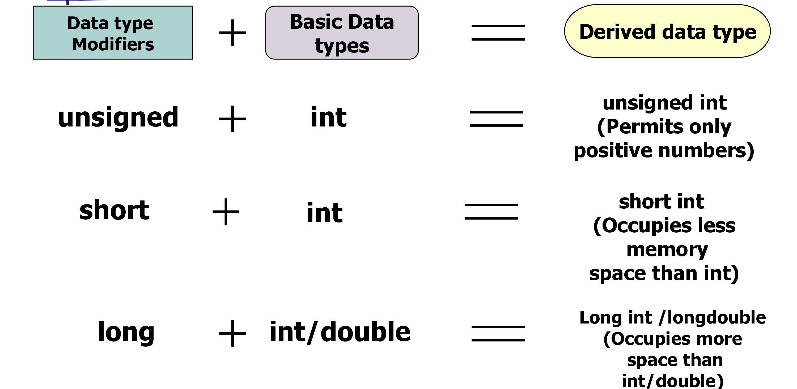
Derived data type
Notes:
<number>

Slide 16
Signed , Unsigned ,long and short types
unsigned type specifies that a variable can take only positive values​
unsigned int varNum; ​
varNum=23123; ​
varNum is allocated 2 bytes​
modifier may be used with the int and float data types​
unsigned int supports range from 0 to 65535
signed type specifies that a variable can take positive & negative values​ int varNum; ​
varNum=-12; ​
varNum is allocated 2 bytes​
modifier may be used with the int and float data types​
unsigned int supports range from -32,768 to +32767
A short int occupies 8 bits (1 byte) ​
allows numbers in the range -128 to 127 ​
long int occupies 32 bits (4 bytes) ​
long double occupies 128 bits (16 bytes)
Notes:
<number>

Slide 17
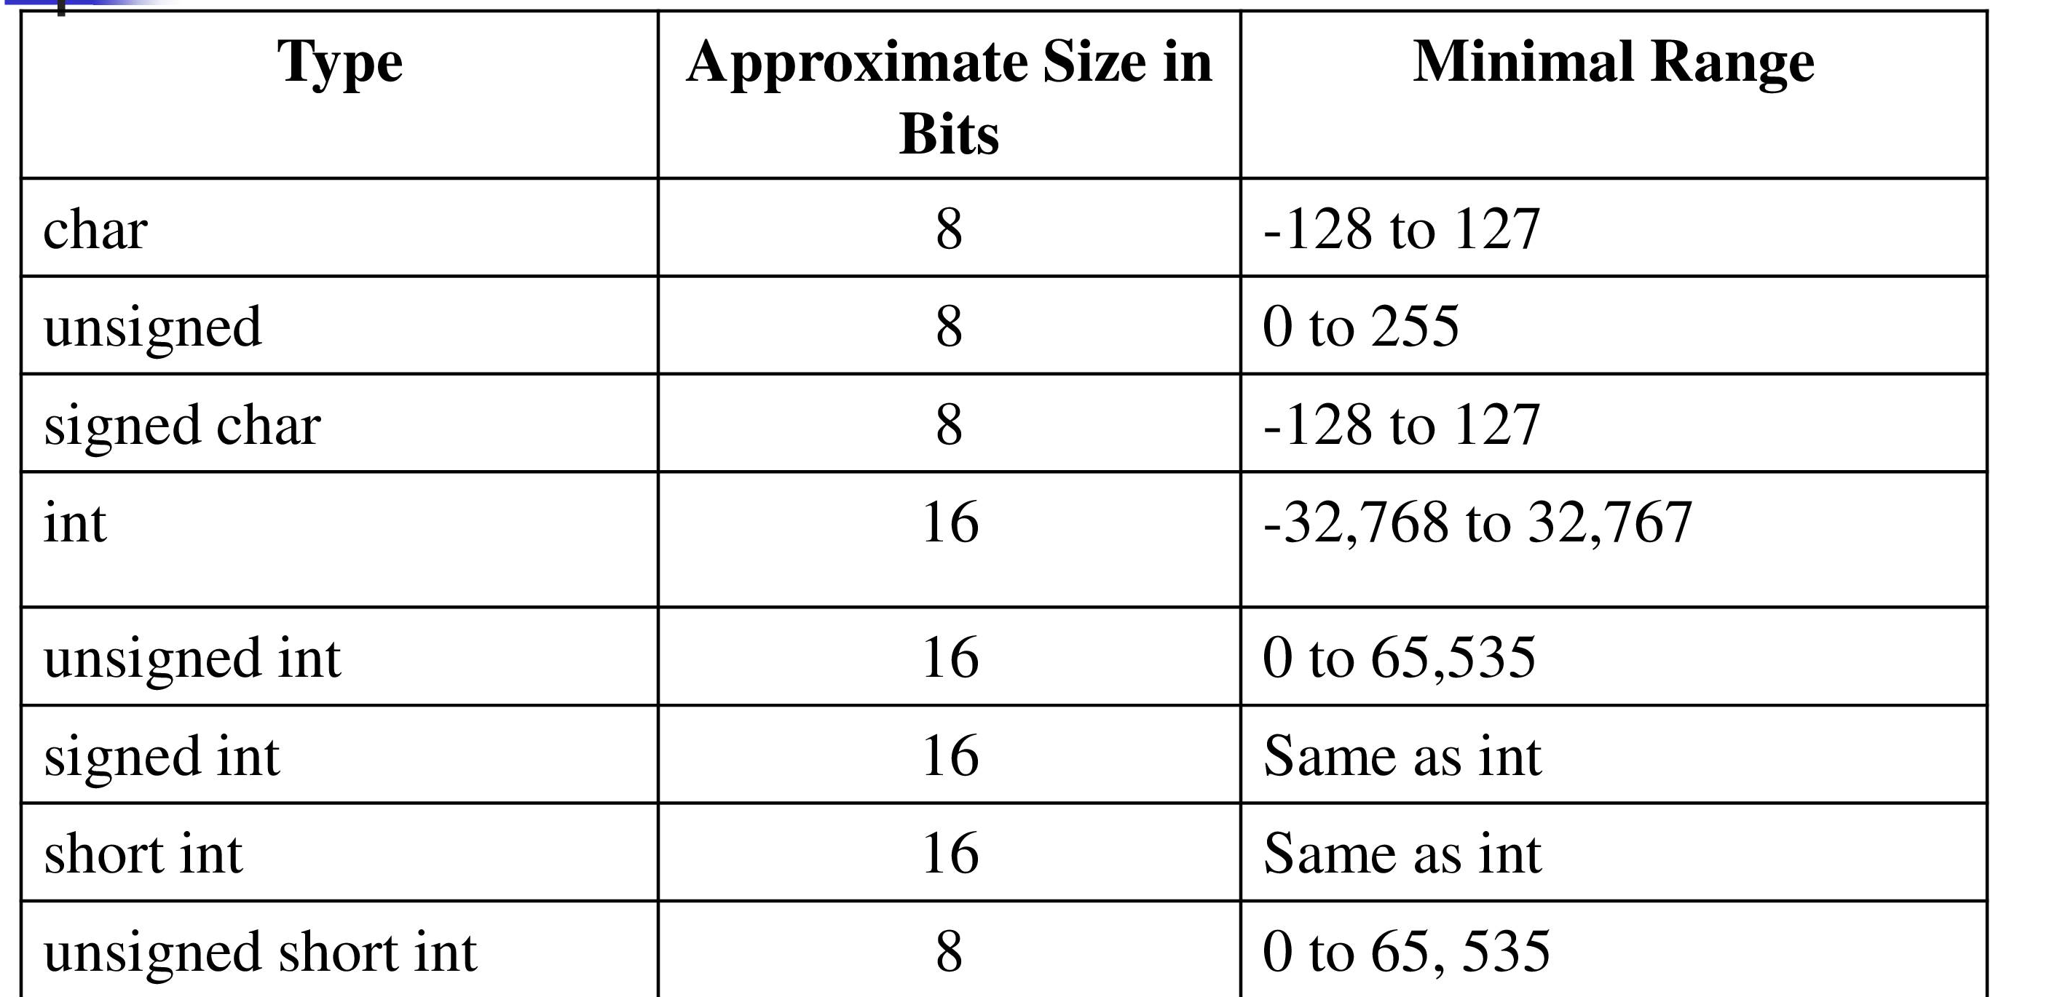
data types & range
Notes:
<number>

Slide 18
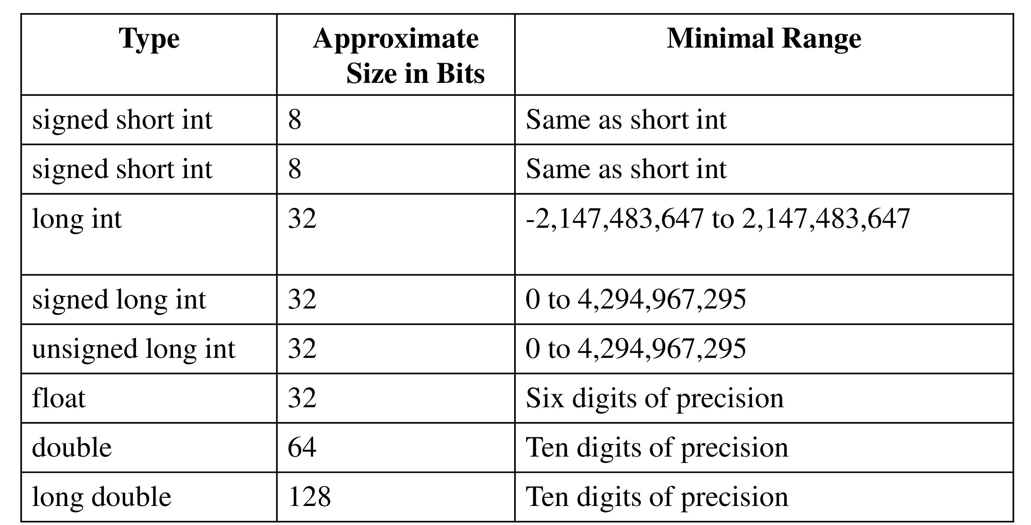
data type & range
Notes:
<number>

Slide 19
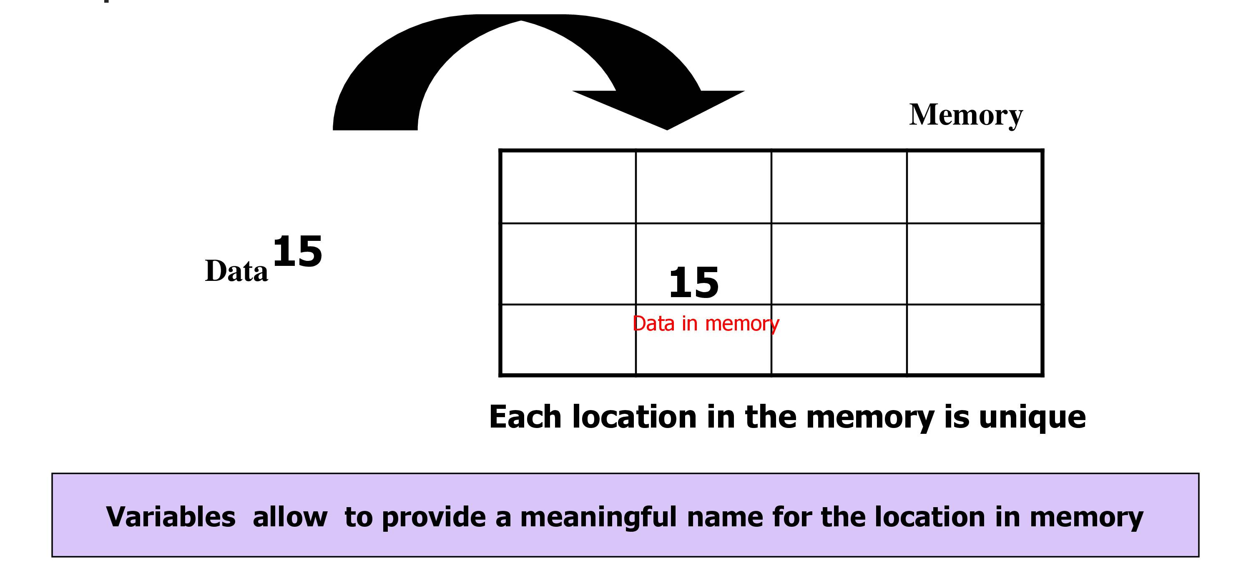
Variables
Notes:
<number>

Slide 20
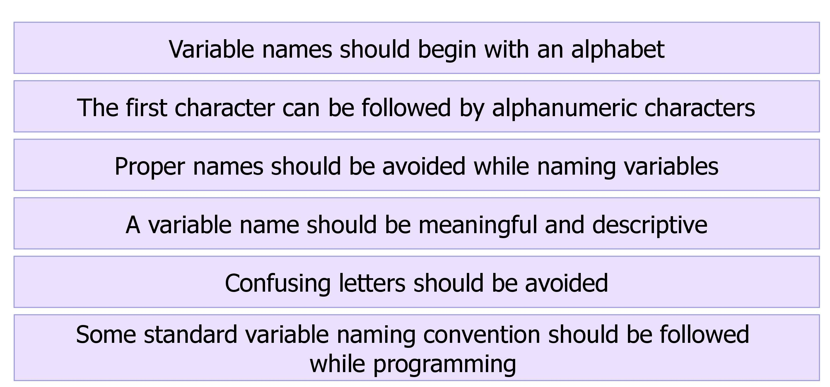
Variables
Notes:
<number>

Slide 21
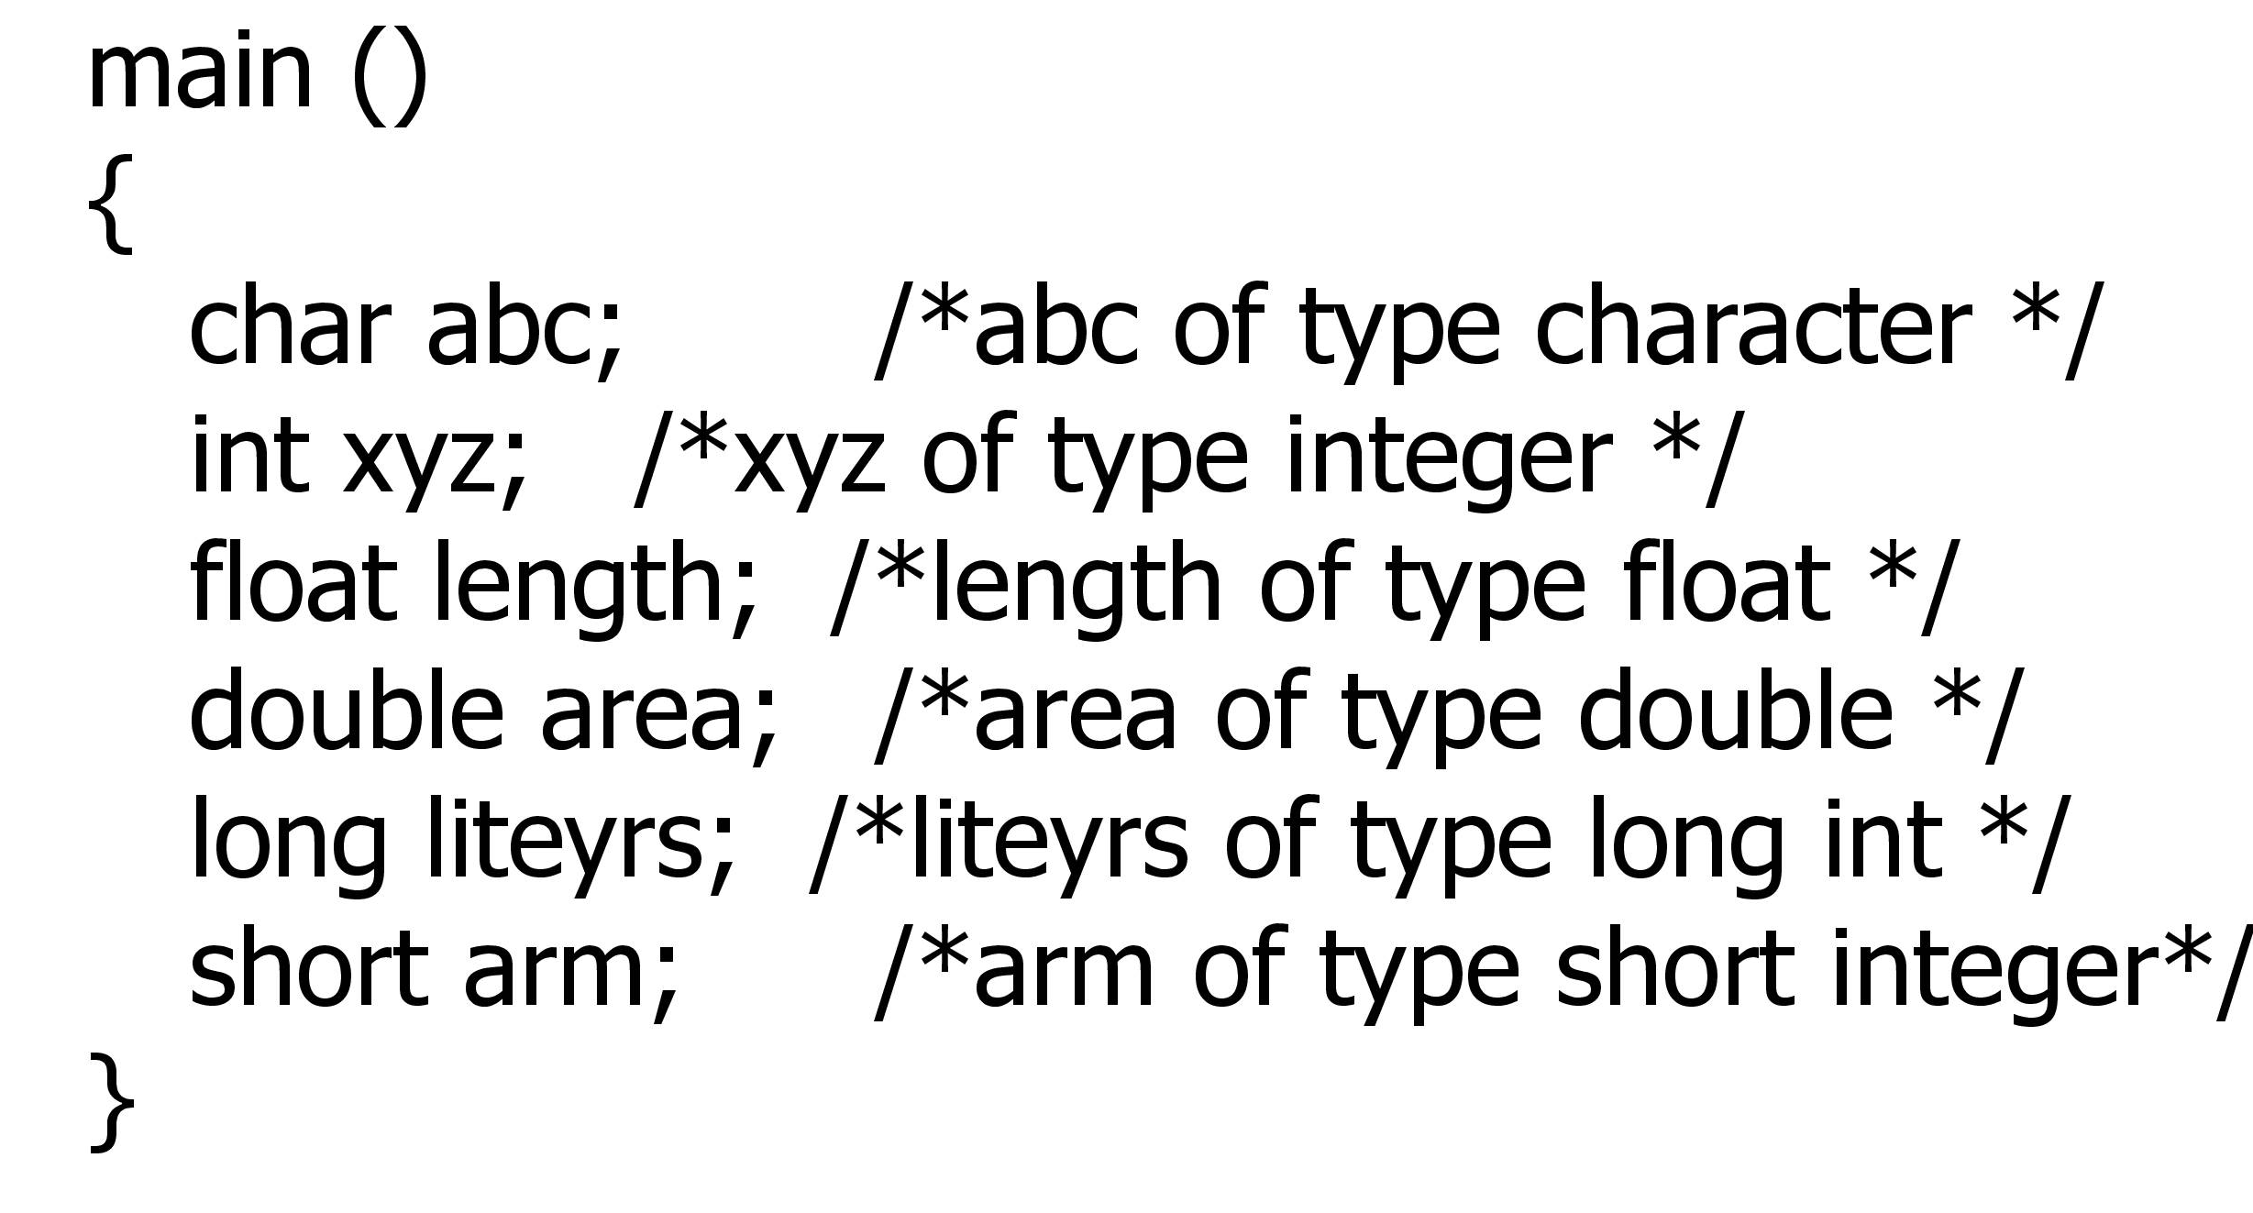
Sample-Declaration
Notes:
<number>

Slide 22
Thank You

